Slide 1
Exploring Mental Health Data
A Kaggle-based project.

Slide 2
Table of contents
01
02
03
04
05
06
07
08
Introduction
Related work
Project objectives
You can describe the topic of the section here
You can describe the topic of the section here
You can describe the topic of the section here
Methods
Results
Data collection & Dataset
You can describe the topic of the section here
Youic of the section here
Discussions and Observations
You can describe the topic of the section here
Refrences

Slide 3
Introduction
01

Slide 4
Introduction
This project is based on developing and implementing machine learning models that can predict depression with high accuracy utilizing a mental health dataset. It further demonstrates the potential of machine learning in healthcare for early diagnosis and intervention.
Why:
Machine learning algorithms have the ability to complement and improve significantly on traditional methods of diagnosis.
According to WHO, there’s been a 25% increase in depression and anxiety disorders.[1]

Slide 5
02
Related Work
Here is where your presentation begins

Slide 6
Related work
Identifying depression predictors from standard health surveys using machine learning.[3]
Methods: AdaBoost, Decision Tree, KNN, SVM, Random Forest, Naive Bayes, Neural Networks
Evaluation: AUC, ROC, accuracy, sensitivity, precision , recall and F1 Score
Conclusion: The study identified strongly correlated features of depression, demonstrated that ML algorithms can accurately identify depression predictors and proposed that heterogeneous data improve ML models performance.
Machine learning models predict the emergence of depression in Argentinean college students during periods of COVID-19 quarantine.[2]
Methods: Classification Models (Logistic Regression, SVM, Random Forests) and Linear Regression Model
Evaluation: Classification Models - Balanced Accuracy, F1 Score, Brier Loss, AUPRC
Linear Regression Model - R-square values, Mean Squared Error, and Mean Absolute Error.
Conclusion: This study highlights the relevance of pre-existing depression and anxiety conditions in predicting depression and the potential of Machine Learning in the timely detection of at-risk students.

Slide 7
Project Objectives
03

Slide 8
Objectives
Develop Predictive Models for Depression
Demonstrate the potentials of Machine Learning in contributing to healthcare

Slide 9
04
Data Collection & Dataset

Slide 10





Data Collection
Source
Target
Key Features
Kaggle Playground Series (S4E11)
Depression
Academic and Work Pressure, Study and Job Satisfaction, Sleep Duration, Dietary Habits, etc.
Accessibility
Data size
Train Data 140700 Rows and 20 Columns,
Test Data 93800 Rows and 19 Columns.
Publicly Available, Structured dataset

Slide 11
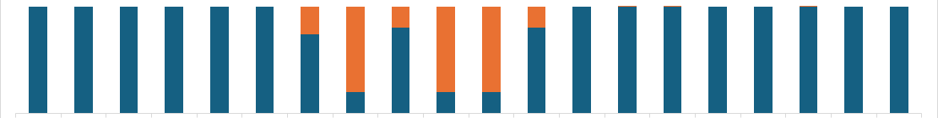
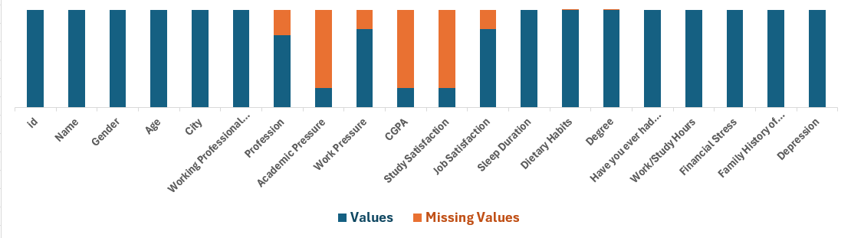
Overview of DataSet
Train Data before EDA
Test Data before EDA

Slide 12
05
Methods
Here is where your presentation begins

Slide 13
Baseline Models
Voting Classifier
Logistic Regression
Decision Trees
Combined predictions from Logistic Regression and Decision Trees using a soft voting approach.
Split data into groups based on feature values for straightforward decision-making.
Predicted depression likelihood based on weighted input features.
Failed to capture nonlinear relationships in the data.
Struggled with class imbalances in the dataset.
Limitations:

Slide 14
Proposed Methods
Gradient Boosting
XGBoost
LightGBM
An iterative ensemble method that builds models sequentially, correcting the errors of previous models to improve accuracy.
An optimized implementation of Gradient Boosting that focuses on speed and performance, with advanced regularization techniques.
A fast, efficient boosting algorithm designed for large datasets and low memory usage, leveraging histogram-based splitting for better performance.
Key Advantages:
Improved predictive accuracy and performance metrics.
Effectively Captured complex patterns in the data.

Slide 15
06
Results

Slide 16
Model’s Performance Metrics
90%
0.73
93%
0.81
Base Model (no tuning)
We ran predictions with our base models individually and then combined them in a voting classifier with soft voting, yielding the following result:
Accuracy score
F1 score
Base Model (after tuning)
Next, we tuned the base models to optimize their performance, yielding the following results:
Accuracy score
F1 score
Notes:
We initially ran predictions using our individual base models. Subsequently, we combined these models using a voting classifier to create an ensemble model with soft voting. This approach yielded the following results.

Slide 17
Model’s Performance Metrics
93.83%
0.83
94%
0.83
Main ML Model (no tuning)
We ran predictions with our main models individually and then combined them in a voting classifier with soft voting, yielding the following result.:
Accuracy score
F1 score
Main ML Model (after tuning)
Next, we tuned the main ML models to optimize their performance, yielding the following results:
Accuracy score
F1 score
Notes:
Applying these findings to the main, we see not much of a significant improvement but a slight improvement in the tuned voting classifier for the main models from the non-tuned voting classifier. This indicates that more hyperparameter tuning needs to be performed on the main algorithms for a better performance of the model.
In summary Our project successfully developed a robust predictive model for depression, with high accuracy and balanced performance.

Slide 18
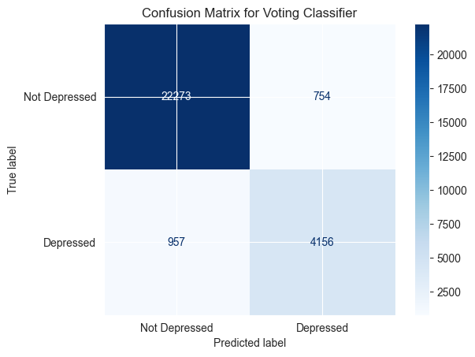
Confusion Matrix
The confusion matrix reveals the final model's strength in accurately predicting "Not Depressed" individuals, with high precision and recall indicating robust performance. However, the trade-off in recall for the "Depressed" class highlights an area for improvement.
Notes:
By focusing on enhancing recall through adjusted thresholds, better feature selection, and more extensive hyperparameter tuning, the model can become more balanced and effective in identifying individuals at risk of depression.

Slide 19
07
Discussions and Observations

Slide 20
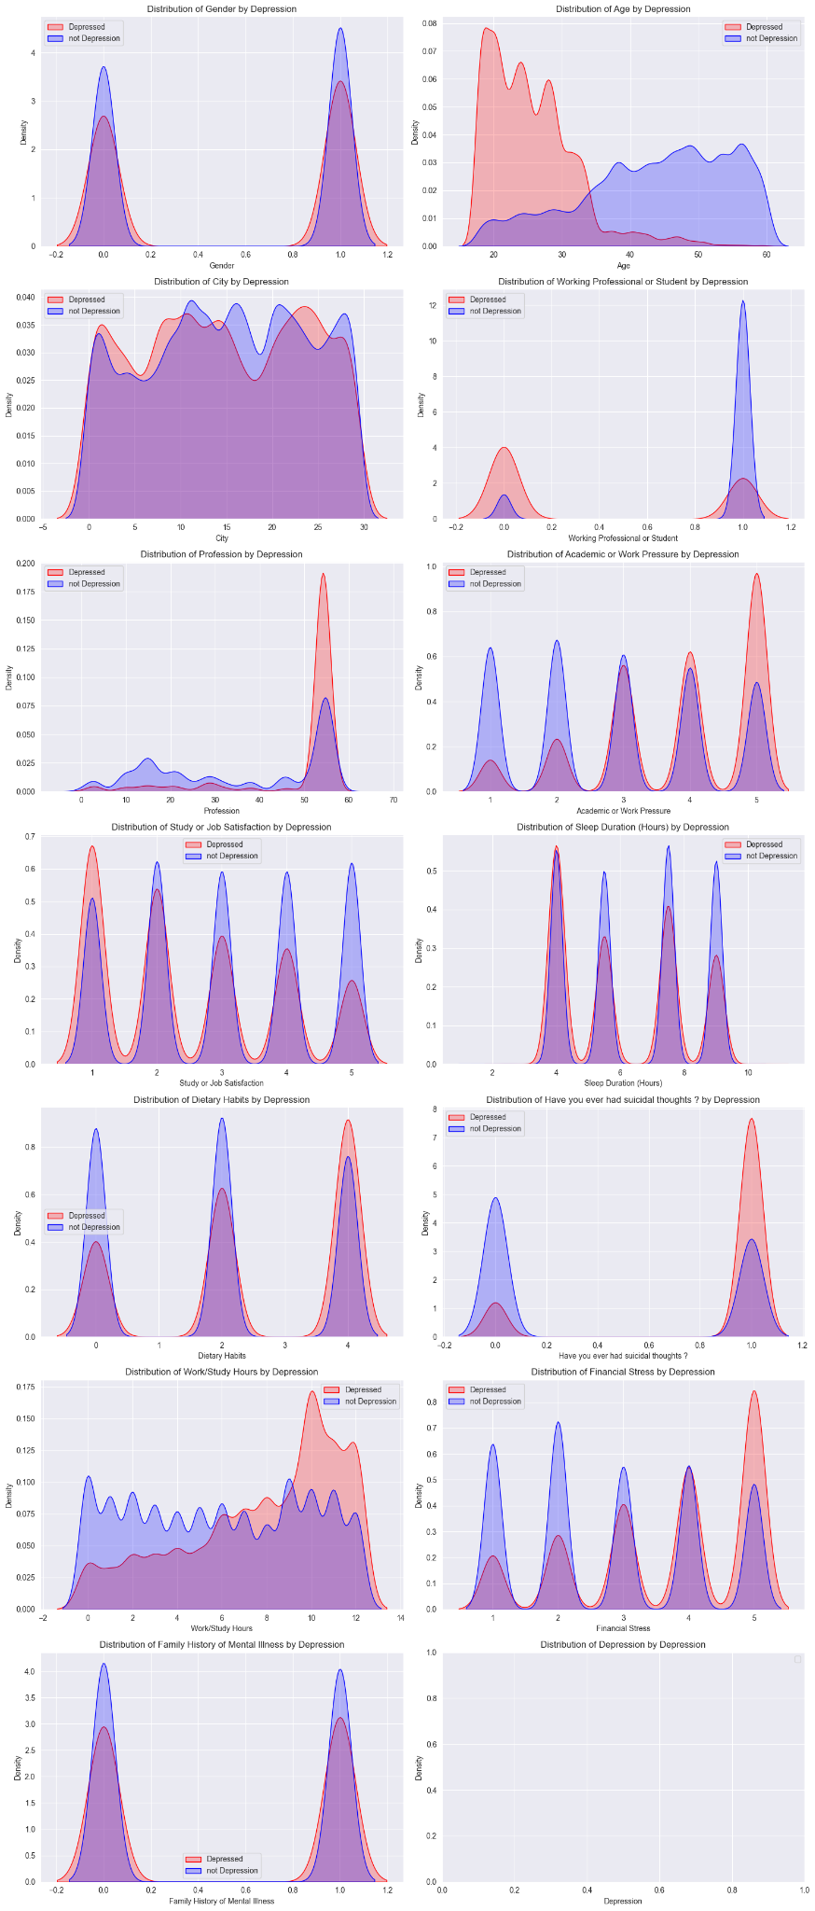

Slide 21
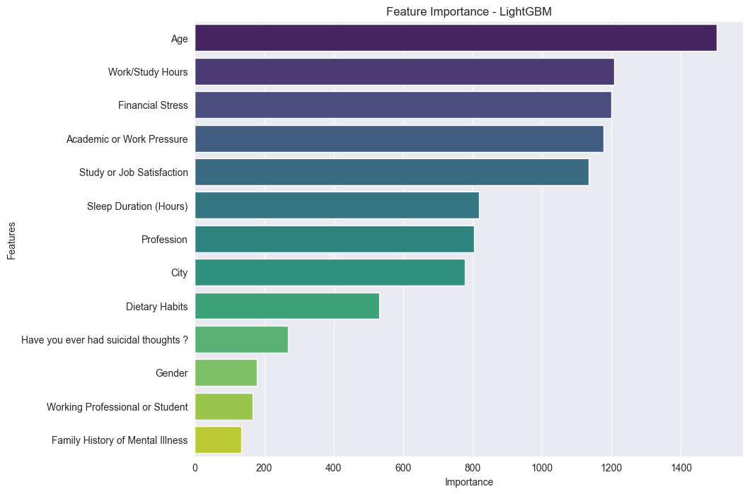
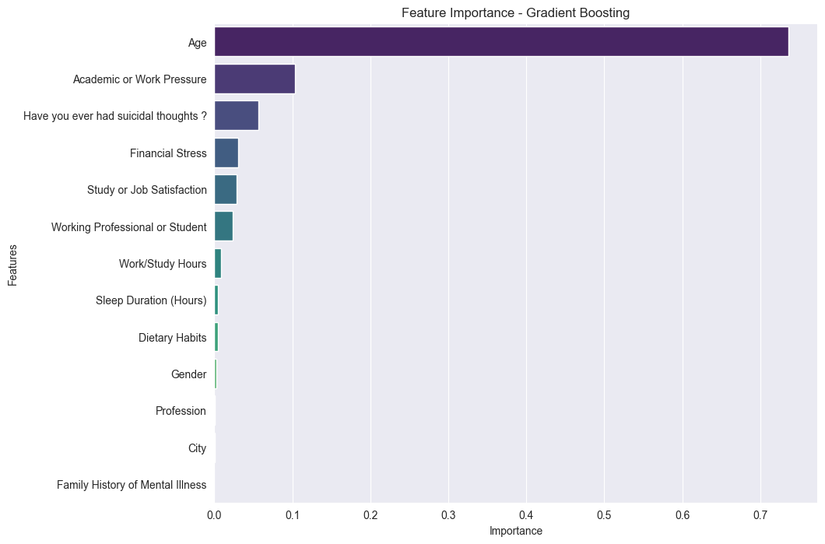
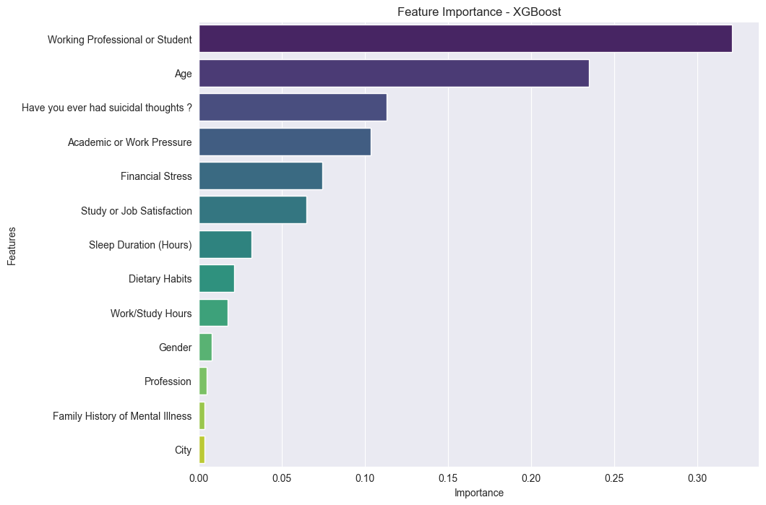
Feature Importance
Age, work/study hours, financial stress, and suicidal thoughts are key predictors across LightGBM, Gradient Boosting, and XGBoost models. Additionally, ‘Academic or Work Pressure’ is important in LightGBM and Gradient Boosting, while ‘Working Professional or Student’ is notable in XGBoost.

Slide 22
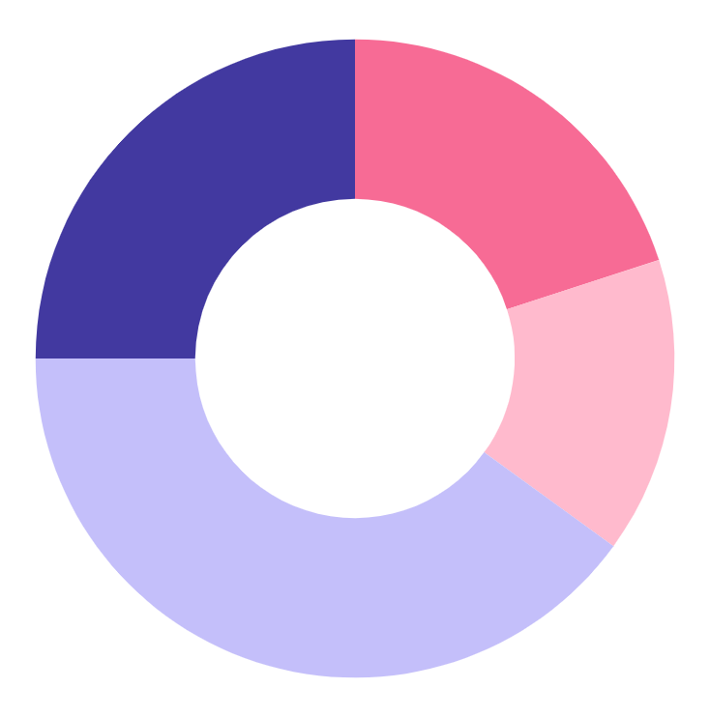
Depression Statistics based on data and model prediction
Financial stress
Work/study hours n stress
Age
Suicidal thoughts
25%
20%
40%
15%
Notes:
The fact that age, work/study hours and stress, financial stress, and suicidal thoughts are consistently highlighted across all three models indicates that these features are universally significant in predicting depression. This consistency suggests that different ensemble methods agree on these key indicators of depression.
The feature importance analysis not only validates the significance of key predictors but also provides insights into how different models interpret these features. This understanding can guide the refinement of existing models, the development of new features, and the strategic selection of models based on specific needs and contexts. By leveraging these insights, future iterations of the models can be more targeted and effective in predicting depression.

Slide 23
More Observations
The base models show a significant performance increase after hyperparameter tuning. This indicates that tuning the models leads to better performance.
For the main ML models, we see not much of a significant improvement but a slight improvement in the tuned voting classifier for the main models from the non-tuned voting classifier. This indicates that more hyperparameter tuning needs to be performed on the main algorithms for a better performance of the model.
Notes:
We use a small amount of parameters for the hyperparameter tuning of the main model due to the complexity of these models and how large it takes to run. Because of this we could not optimize the tuning to get the model leading to not much of a significant increase in the tuned models

Slide 24
Our team
Hephzibah Jayaraj
Ginikachi Oyakhare
Enyojo Phoebe Alabi

Slide 25
References
[1] K. K. Park, M. Saleem, M. A. Al-Garadi, and A. Ahmed, “Machine learning applications in studying mental health among immigrants and racial and ethnic minorities: an exploratory scoping review,” BMC Medical Informatics and Decision Making, vol. 24, no. 1, Oct. 2024, doi: https://doi.org/10.1186/s12911-024-02663-4.
[2] L. C. López Steinmetz, M. Sison, R. Zhumagambetov, J. C. Godoy, and S. Haufe, “Machine learning models predict the emergence of depression in Argentinean college students during periods of COVID-19 quarantine,” Frontiers in psychiatry, vol. 15, no. 38690202, p. 1376784, Winter 2024, doi: https://doi.org/10.3389/fpsyt.2024.1376784.
[3] Ali Akbar Jamali, C. Berger, and R. J. Spiteri, “Identification of Depression Predictors from Standard Health Surveys using Machine Learning,” Current Research in Behavioral Sciences, vol. 7, no. 100157, pp. 100157–100157, Jun. 2024, doi: https://doi.org/10.1016/j.crbeha.2024.100157.

Slide 26
Thank You!

